Slide 1

Dynamic Programming
Design and Analysis of
Algorithms
Rajesh Kumar Tripathi
Assistant Professor, Dept. CEA

Slide 2
Dynamic Programming
A dynamic-programming algorithm solves each subsubproblem just once and then saves its answer in a table, thereby avoiding the work of recomputing the answer every time it solves each subsubproblem
Dynamic programming is applied when the sub-problems overlaps-
-- when sub-problems share sub-subproblems.
-- apply it to optimization problems

Slide 3
Dynamic Programming
Dynamic programming is used for optimization problems:
-- 0/1 Knapsack
-- Longest common sub-sequence
-- Matrix chain multiplication
-- Resource allocation problems
-- All pair shortest paths

Slide 4
Dynamic Programming
Dynamic programming steps:
-- Characterize the structure of an optimal solution
-- Recursively define the value of an optimal solution
-- Compute the value of an optimal solution, typically in a bottom-up fashion.
-- Construct an optimal solution from computed information.

Slide 5
All Pair Shortest Paths
Design and Analysis of
Algorithms
Rajesh Kumar Tripathi
Assistant Professor, Dept. CEA

Slide 6
All pair shortest paths
Find shortest paths between all pairs of vertices in a graph.
This problem might arise in making a table of distances between all pairs of cities for a road atlas.

Slide 7
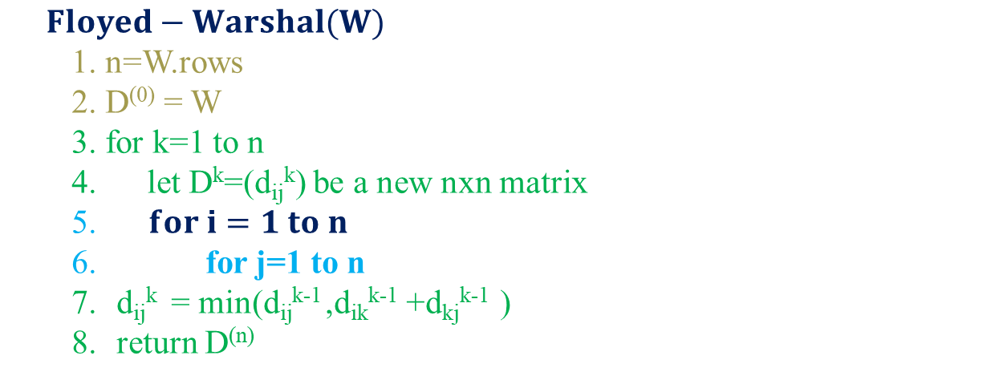
Floyd-Warshal Algorithm
$Floyed−Warshal(W)$
1. n=W.rows
2. D⁽⁰⁾ = W
3. for k=1 to n
4. let D^{k}=(d_{ij}^{k}) be a new nxn matrix
5. $for i=1 to n$
6. for j=1 to n
d_{ij}^{k} = min(d_{ij}^{k-1} ,d_{ik}^{k-1} +d_{kj}^{k-1} )
return D^{(n)}

Slide 8
Floyd-Warshal Algorithm
$Floyed−Warshal(W)$
1. n=W.rows
2. D⁽⁰⁾ = W
3. for k=1 to n
4. let D^{k}=(d_{ij}^{k}) be a new nxn matrix
5. $for i=1 to n$
6. for j=1 to n
d_{ij}^{k} = min(d_{ij}^{k-1} ,d_{ik}^{k-1} +d_{kj}^{k-1} )
return D^{(n)}

Slide 9
Floyd-Warshal Algorithm
$Floyed−Warshal(W)$
1. n=W.rows
2. D⁽⁰⁾ = W
3. for k=1 to n
4. let D^{k}=(d_{ij}^{k}) be a new nxn matrix
5. $for i=1 to n$
6. for j=1 to n
d_{ij}^{k} = min(d_{ij}^{k-1} ,d_{ik}^{k-1} +d_{kj}^{k-1} )
return D^{(n)}

Slide 10

Floyd-Warshal Algorithm
$Floyd−Warshal(W)$
1. n=W.rows
2. D⁽⁰⁾ = W
3. for k=1 to n
4. let D^{k}=(d_{ij}^{k}) be a new nxn matrix
5. $for i=1 to n$
6. for j=1 to n
d_{ij}^{k} = min(d_{ij}^{k-1} ,d_{ik}^{k-1} +d_{kj}^{k-1} )
return D^{(n)}

Slide 11
Floyd-Warshal Algorithm
$Floyed−Warshal(W)$
1. n=W.rows
2. D⁽⁰⁾ = W
3. for k=1 to n
4. let D^{k}=(d_{ij}^{k}) be a new nxn matrix
5. $for i=1 to n$
6. for j=1 to n
d_{ij}^{k} = min(d_{ij}^{k-1} ,d_{ik}^{k-1} +d_{kj}^{k-1} )
return D^{(n)}

Slide 12
Floyd-Warshal Algorithm
$Floyed−Warshal(W)$
1. n=W.rows
2. D⁽⁰⁾ = W
3. for k=1 to n
4. let D^{k}=(d_{ij}^{k}) be a new nxn matrix
5. $for i=1 to n$
6. for j=1 to n
d_{ij}^{k} = min(d_{ij}^{k-1} ,d_{ik}^{k-1} +d_{kj}^{k-1} )
return D^{(n)}

Slide 13
Floyd-Warshal Algorithm
$Floyed−Warshal(W)$
1. n=W.rows
2. D⁽⁰⁾ = W
3. for k=1 to n
4. let D^{k}=(d_{ij}^{k}) be a new nxn matrix
5. $for i=1 to n$
6. for j=1 to n
d_{ij}^{k} = min(d_{ij}^{k-1} ,d_{ik}^{k-1} +d_{kj}^{k-1} )
return D^{(n)}

Slide 14
Thank You

